Slide 1
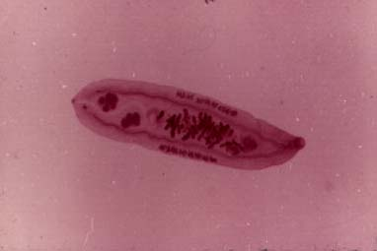

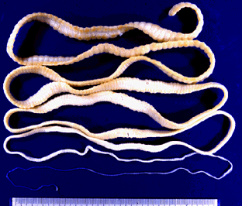
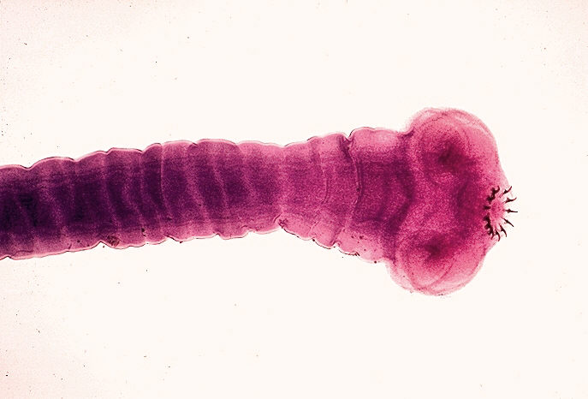
Introduction to Helminthology

Slide 2
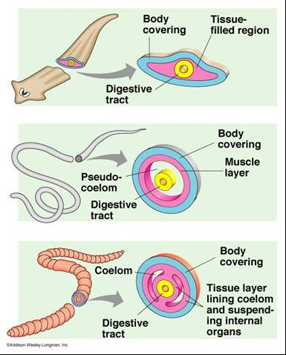
HELMINTHES (WORMS) - Characteristics
Eukaryotic, multicellular
animals that usually have
digestive, circulatory,
nervous, excretory,
and reproductive systems.
2. Worms with bilateral
symmetry, head and tail,
and tissue differentiation
(endoderm, mesoderm,
and ectoderm).
Flatworm
Roundworm
Earthworm

Slide 3
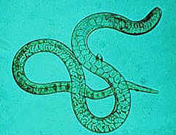
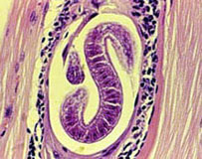
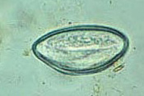
Helminthes
  helminths are worm-like parasites.
  Helminths are separated according to their general external shape and the host organ they inhabit.
The definitive classification is based on the external and internal morphology of egg, larval, and adult stages

Slide 4
Helminthes
Life Cycle
Extremely complex (egg → larva → adult)
Intermediate hosts harbor larval (developmental) stage.
Definitive host harbors adult stage.
Sexual reproduction strategies
1- Male and female reproductive organs are found in separate individuals.
2- One animal has both male and female sex organs (most hermaphrodites copulate with other animals, a few copulate with themselves).

Slide 5
Ways of transmission
Fecal-oral
Contaminated food, water
Ingestion of meat (larvae)
Through skin
Through vector
Localization
Intestinal helminthes
Blood and tissue helminthes

Slide 6
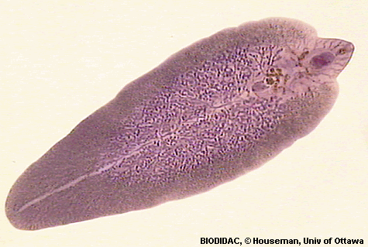
Phylum: Platyhelminthes
شعبه الديدان المسطحه

Slide 7
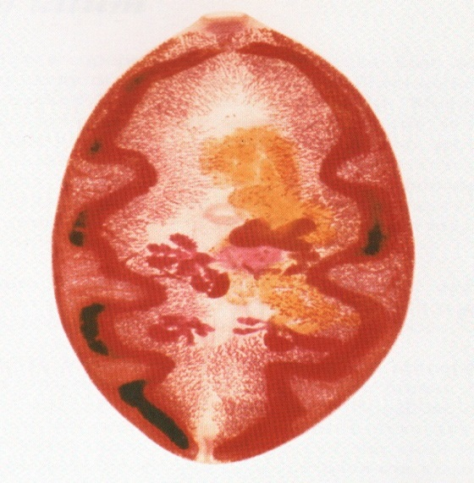
Ggeneral characteristic of Flatworms
(Phylum Plathelminthes)
The flatworms consists of 12, 200 species, including classes of parasitic worms: Trematoda, Cestoda
Dorso-ventrally flattened worms
Bilaterally symmetrical
Possess an incomplete digestive tract
Lack body cavity (Acoelomate)
Without special skeletal, circulatory or respiratory systems.
They are mostly hermophroditic (Both sexes are contains in one individual) with few exceptions.

Slide 8
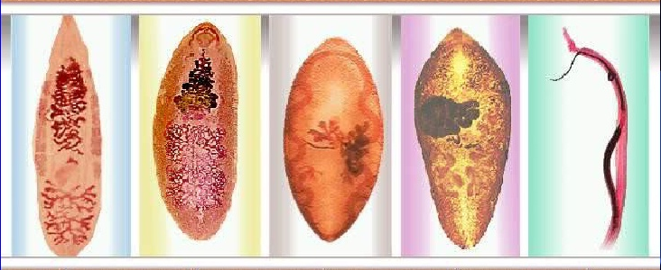
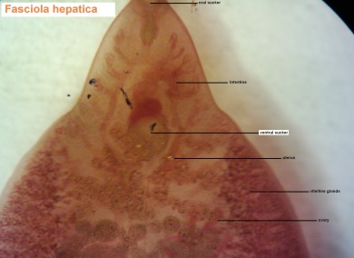
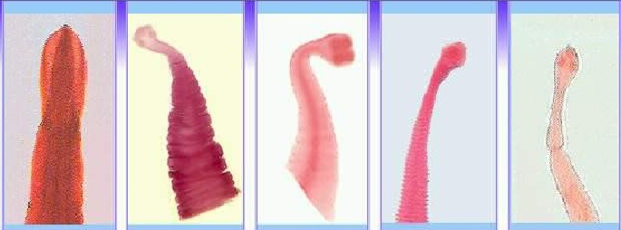
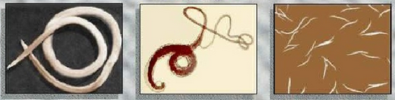

Helminthes classification
1. Trematodes (Flukes)
Faciola
hepatica
2. Cestodes (Tape worms)
3. Nematodes (Round worms)

Slide 9
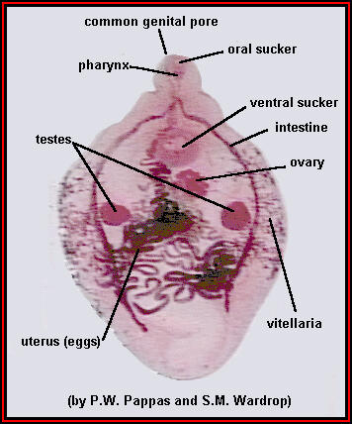
General characteristic of Class Trematoda
صنف المخرمات
1) Flattened dorsoventrally (leaf-like).
2) Unsegmented.
3) Body is covered by cuticle.
4) Organs of fixation: oral sucker, ventral sucker.
5) Organs and systems: digestive system, excretory system, nervous system. Genital system: Trematodes are hermaphrodites except genus Schistosoma.
6) The life cycle is passed in two hosts (alternation of hosts) and has sexual and asexual stages.

Slide 10
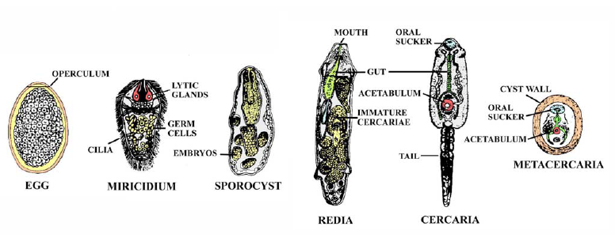
Order: Digenea
Divided into four groups according to the site where worm presence:
1- Liver Fluke
2- Intestinal Fluke
3- Lung Fluke
4- Blood Fluke

Slide 11
Clonorchis sinensis
Scientific name: Clonorchis sinensis
Common name :Chinese or Oriental Liver Fluke
Disease : Clonorchiasis
Infective stage: Metacercaria
Transmission: fecal-oral (ingestion of contaminated raw, frozen, dried, pickled, and salted fish).
Final hosts: carnivorous mammals and humans.
Intermediate hosts:
1- snail (miracidium, sporocyst, rediae, cercariae),
2 - fish Cyprinidae genus- the family that includes carp and goldfish (metacercariae).
Diagnosis: Ova are found in faeces
Presence in the host: Adults lives in bile ducts of human and mammals eat fish (Cats, Dogs)
Distribution: endemic in Far East, China, Japan, and Vietnam.
Localization: bile ducts, gallbladder, and pancreas.

Slide 12
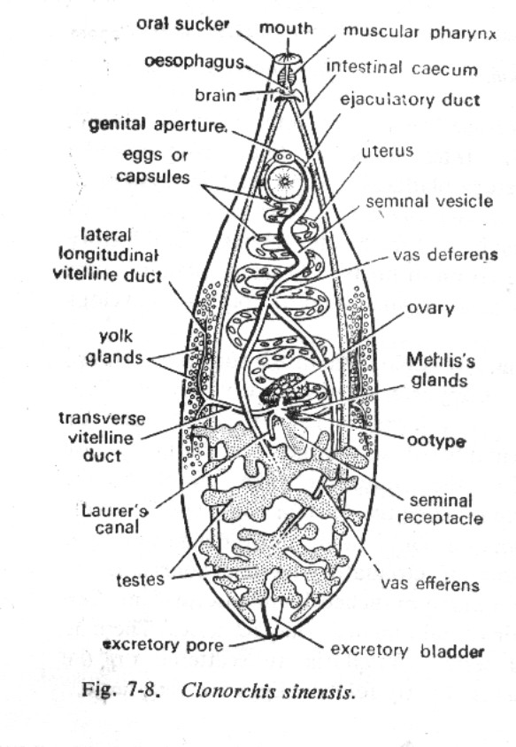
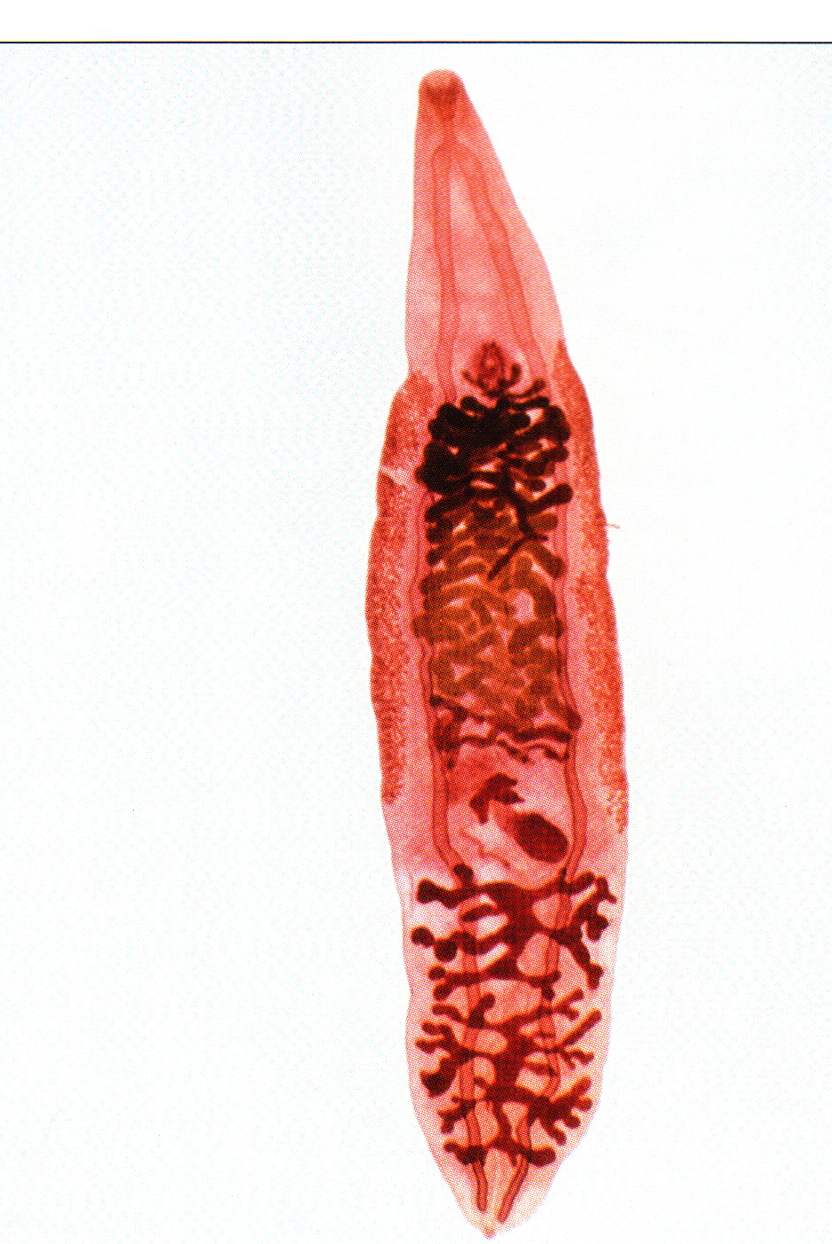
Adults
Oral sucker
cecum
Ventral sucker
Uterus
Vitelline gland
Ovary
Ootype
Seminal receptacle
Laurer’s canal
testes
Clonorchis sinensis
الطول من 10 - 25 ملم

Slide 13
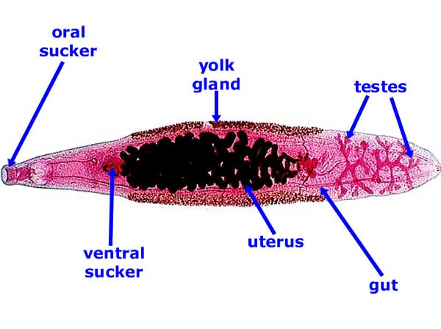
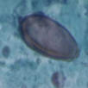
Clonorchis sinensis
Morphology: the adult worms are 1 to 2 cm; the eggs are small, brownish.

Slide 14
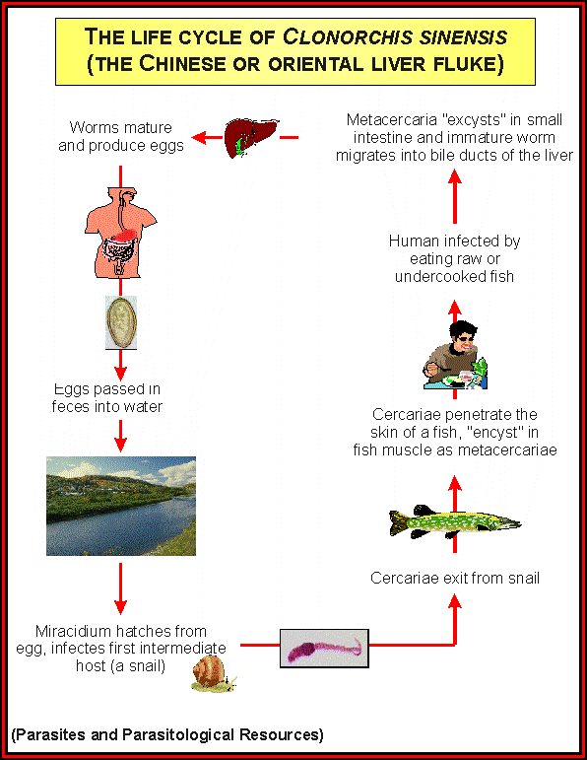
Clonorchis sinensis
Clinical disease: cholecystitis and cholelithiasis, hepatic colic, associated with profound weight loss and diarrhea. An individual fluke may live for 15-30 years in the liver. In humans a heavy infestation of liver flukes may cause cirrhosis of the liver and death.
Prevention: adequate cooking of fish and proper disposal of human waste

Slide 15
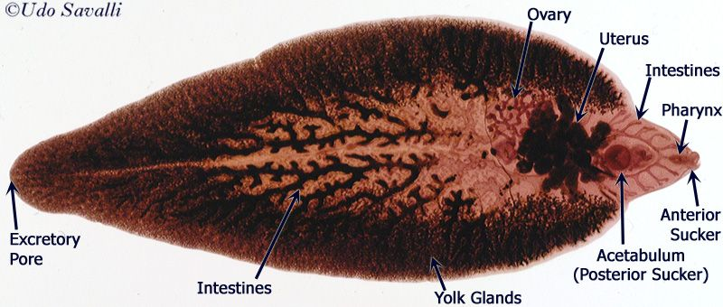
Fasciola hepatica
Scientific name: Fasciola hepatica
Common name: Sheep liver fluke
Disease: Liver rot
Presence in the host: The adults live in the Bile ducts of sheep, caws, and
sometimes could infect human.
Distribution: endemic in Far East.
Localization: bile ducts, gallbladder, and pancreas.
Infective stage: Metacercaria

Slide 16
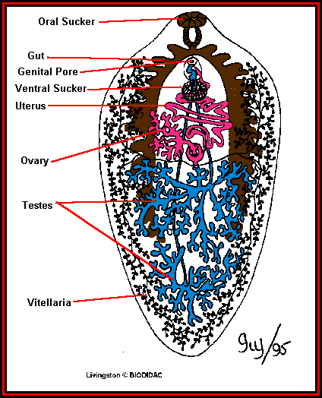
Fasciola hepatica
Morphology: large size (3-5 cm) and conical form of the body; possess sucking disks (oral and abdominal) that provide them motion. Multi branched uterus is situated under the abdominal sucking disk. Testes are branched too and situated in the middle part of the body.

Slide 17
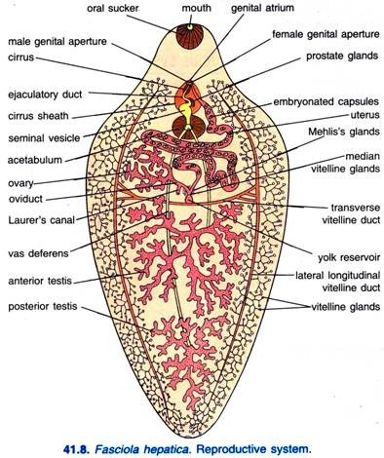
Male and female reproductive system
Male
2 testes
Vas defferens
Cirrus pouch
Genital pore
Female
Single ovary
Oviduct
Ootype
Uterus
vagina
Vitelline duct

Slide 18
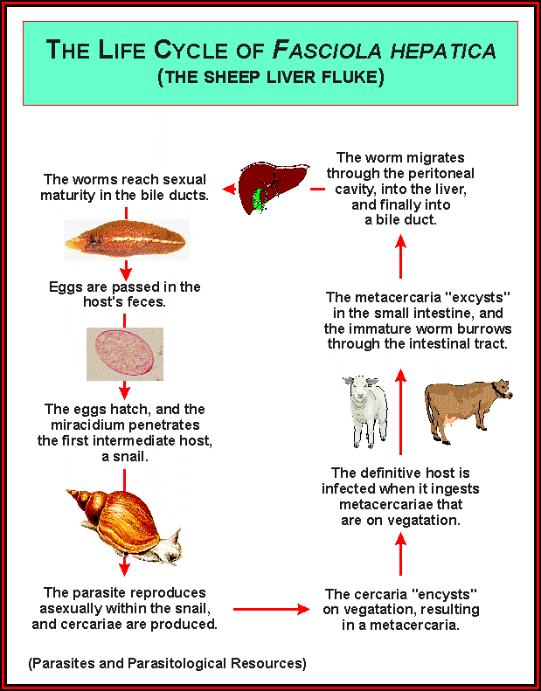
Fasciola hepatica
Life-cycle:
Final host - herbivorous mammals (horses) and humans.
Intermediate host — the snail Lymnaea truncatula.
Transmission: fecal-oral (ingestion of water , some non-water plants and vegetables, which contain metacercaria).

Slide 19
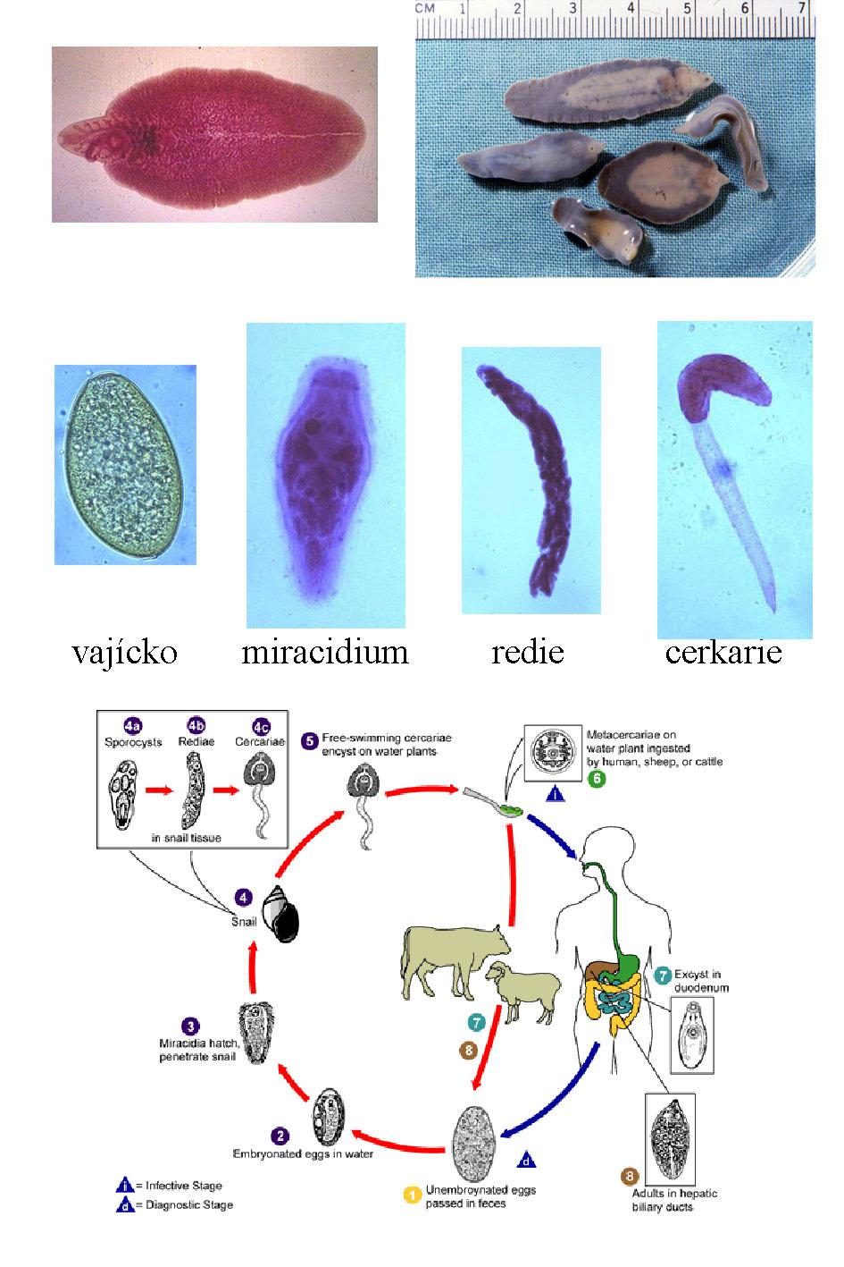
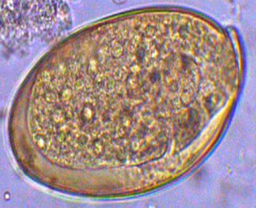
Fasciola hepatica
Clinical disease: Parasites obstruct bile ducts and lay eggs within them, leading to cholelithiasis (gallstones). Biliary obstruction can occur, sometimes causing biliary cirrhosis.
Diagnosis: immature eggs in feces. An egg has large sizes, thin membrane, yellow color and small cover in one pole.
Prevention: involves not eating wild aquatic vegetables.

